Slide 1
Time Will Tell

Slide 2
Instructions:
Add the two numbers being pointed to on the clock.
Determine if the sum of the two numbers is even or odd.

Slide 3
3. Finally, keep count of each occurrence of 6 o’clock.

Slide 4
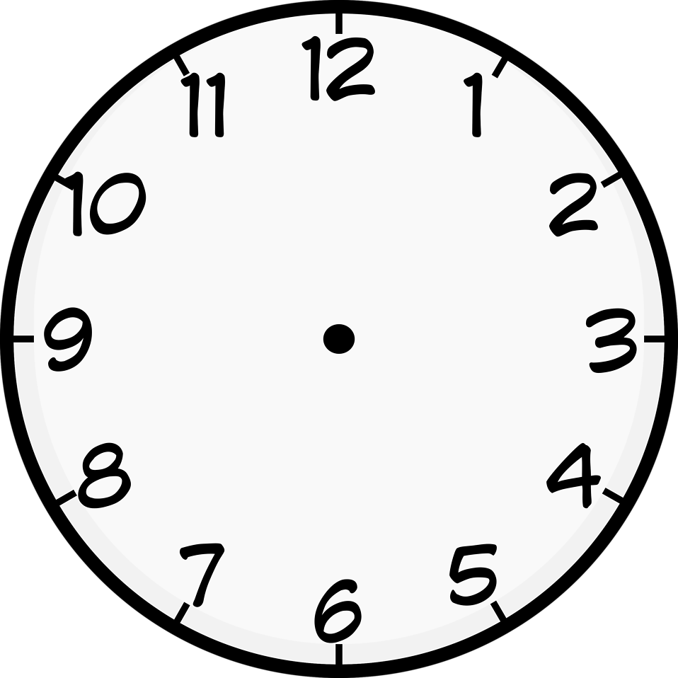

Slide 53
Time to Finish!

Slide 54
How many clocks had 6 o’clock?

Slide 55
The last clock was 12:30!
7

